Slide 1
SQL for Data Analysis Project
We will ask four questions about the digital music store database
List of top 10 singers who recorded the most albums ?
Select the customer who spends the most on music for each country?
Who is the highest earning artist according to Invoice Lines ?
Who is writing the rock music ?
Created By
Ahmed Darwish

Slide 2
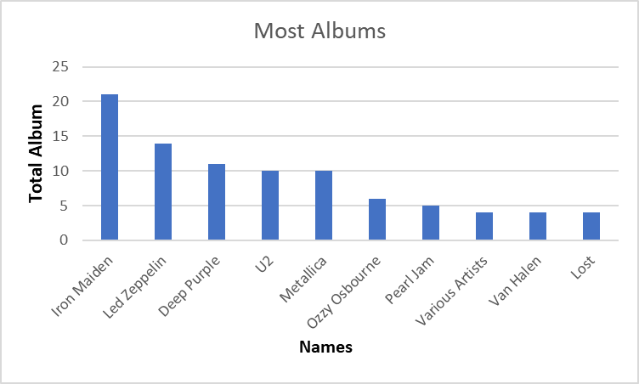
List of top 10 singers who recorded the most albums ?
The chart shows a list of the 10 most popular singers to record albums.
At the top of the list is the singer Iron Maiden who recorded 21 albums, While at the bottom of the list are Various Artists, Van Halen and Lost recording 4 albums equal for each.
While Led Zeppelin scored 14 albums, Deep Purple recorded 11 albums, U2 recorded 10 albums, with Metallica and Ozzy Osbourne recorded 6 and Pearl Jam recorded 5 albums.

Slide 3
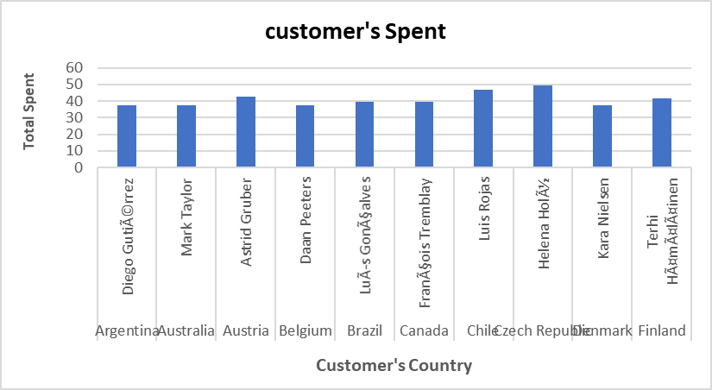
Select the customer who spends the most on music for each country?
The chart shows a list of the 10 customer who spends the most on music for each country.
Czech Republic has the most popular music customer is at the top of the list with 49.62.
Denmark and Belgium and Argentina and Australia are at the bottom of the list with 37.62.

Slide 4
Who is the highest earning artist according to InvoiceLines ?
The graph shows a list of the 10 most profitable singers.
At the top of the list is the singer Iron Maiden who earned 138.6, While at the bottom of the list is Eric Clapton earning 39.6 albums equal for each.
The rest of the singers range between a gain of 41.58 and 105.93.

Slide 5
Who is writing the rock music ?
The chart shows who writes more rock music.
At the top of the list is Led Zeppelin who wrote 114 songs, While at the bottom of the list is kiss writing 35 songs.
The rest of the authors range between a gain of 112 and 40.

